Slide 1


Self-Service Data Provisioning through Semantic Enrichment of Data
Ahmad Assaf
Supervisors
Raphael Troncy (EURECOM)
Aline Senart (SAP)

Slide 2
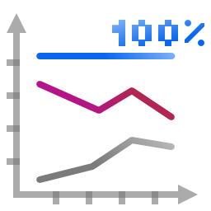

CRM
ERP
SCM
Data Integration in large enterprises is a time and resource costly task
Various approaches have been introduced to solve this integration challenge [2][3][4]:
XML as the underlying data model
Web Services to provide the data exchange protocols and Service Oriented Architecture (SOA)
Linked Data paradigm
Notes:
Enterprises use a wide range of heterogeneous information systems in their business activities such as
Enterprise Resource Planning (ERP), Customer Relationships Management (CRM) and Supply Chain
Management (SCM) systems. An enterprise distributed IT landscape contains multiple systems using
different technologies and data standards. In addition to this heterogeneity, the amount of information
in enterprise databases and on-line data stores expands exponentially each year. Enterprise Big Data isn't
big in volume only, but in the associated le formats also as the information is being stored often in
unstructured and unknown formats.
Big Data -> Volume, Velocity and Variety

Slide 3
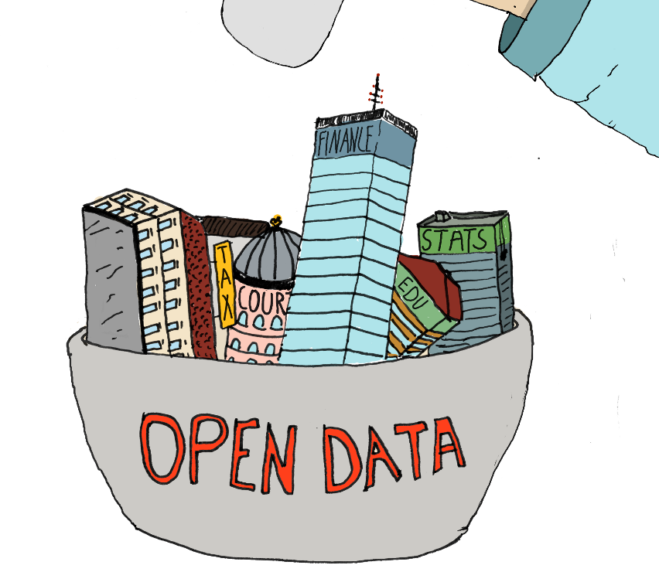
“There is Money in Linked Open Data ”
From 12 datasets cataloged in 2007, the Linked Open Data has grown to almost 300 datasets [6]
32 billion triples [6]
Covering areas in education, transportation, consumer products, electricity, oil and gas, health care and consumer finance
The potential annual value enabled by Open Data in these domains estimates to reach 3 trillion US Dollars [9].

Slide 4

“Big Data” problems are actually BIG “Data Problems”
Notes:
Classic BI and even the newer Agile Visualization tools focus much of their selling features on attractive
and unique visualizations, but it still remains a truth that preparing data for those visualizations is the far
more challenging task in most BI projects large and small. Self Service data provisioning aims at tackling
this problem by providing datasets discovery, acquisition and integration techniques intuitively to the end
user.
Distributed sources with heterogeneous data formats and terminologies
Complex data models
Different storage models
Noisiness (duplications, inconsistencies)
Analyzing this new type of data within the context of existing enterprise data should bring them new or more accurate business insights and allow better recognition of sales and market opportunities

Slide 5
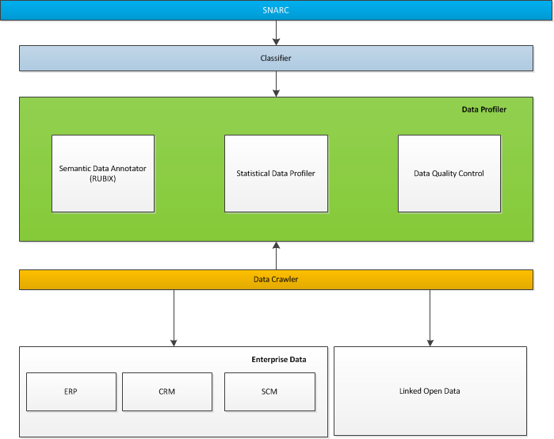
Our Proposal

Slide 6
Crawling Data
Perform the following dataset discovery tasks on internal repositories and external Linked Data hubs:
Data Acquisition
Data Preparation
Data Classification

Slide 7
Data Preparation
Data profiling and validation, de-duplicating and enhancing relevant data sets with metadata. profiling is used to examine data to understand its content, structure and data quality dependencies
Examining column data and getting statistical information.
Dependency tasks
Redundancy tasks
Uniqueness tasks
Content type
Notes:
Examining column data and getting statistical information such as min, max, average, median, null percentage, value distribution, pattern distribution.
Dependency tasks: Finds the values in one or more dependent columns that rely on values in a primary column
Redundancy tasks: Determine the degree of overlapping data values or duplication between two sets of columns
Uniqueness tasks: Returns the count and percentage of rows that contain non-unique data, for the set of column(s) selected.
Content type: Content type profiling provides suggested meaning based on the entities data in the columns.

Slide 8
Tagging and attaching metadata is often seen as additional work for data publishers with few paybacks.
Different data creators use different terminologies which means that the same object maybe be represented using different metadata descriptions [19].
Presenting and enterprise taxonomies requires a considerable amount of time and effort, at least in the initial creation steps [3].

Slide 9
Content Type Identification via RUBIX
RUBIX is a framework that annotates datasets based on the semantics of the data at the instance level
Uses Reference Datasets like DBpedia and Freebase
Able to overcome lots of tradition data integration problems like synonyms, spelling mistakes, different languages, abbreviations … etc.
Improves Schema Matching
Cosine Similarity, Pearson Product-Moment Correlation Coefficient(PPMCC) and Spearman's Rank Correlation Coefficient
Identify topical domains with fine-grained classification

Slide 10
Mapping each cell with a set of “Rich Types”
The Result for Microsoft is: {Software=86.118179, Website=42.362911, Video Game Platform=137.838684, Organization=232.759842, Programming Language=67.981903, File Format=69.533485}
The Result for Apple is: {Physicist=54.597713, Organism Classification=153.355011, Video Game Platform=91.149803, Computer=64.025963, Organization=210.666855, Record label=52.227253}
The Result for Orange is: {Monarch=77.261147, US County=83.572784, Organism Classification=174.263657, Order of Chivalry=55.610447, Organization=157.174515, Color=125.234734}
The Result for IBM is: {Software=32.009403, Operating System=51.03334, Video Game Platform=100.333168, Computer=47.497246, Organization=207.017471, Computing Platform=31.616125}
The Result for Accenture is: {Book=7.331758, Building=11.667136, Organization=77.445473}
Results retrieved from Freebase have a defined confidence score
The confidence score for each type is query independent

Slide 11
Map each column with an aggregated set of “Rich Types”
Column has the following types:
Type : Book has been found 1 time(s), with total confidence = 7.331758
Type : Building has been found 1 time(s), with total confidence = 11.667136
Type : Color has been found 1 time(s), with total confidence = 125.234734
Type : Computer has been found 2 time(s), with total confidence = 111.52320900000001
Type : Computing Platform has been found 1 time(s), with total confidence = 31.616125
Type : File Format has been found 1 time(s), with total confidence = 69.533485
Type : Monarch has been found 1 time(s), with total confidence = 77.261147
Type : Operating System has been found 1 time(s), with total confidence = 51.03334
Type : Order of Chivalry has been found 1 time(s), with total confidence = 55.610447
Type : Organism Classification has been found 2 time(s), with total confidence = 327.61866796
Type : Organization has been found 5 time(s), with total confidence = 885.064156
Type : Physicist has been found 1 time(s), with total confidence = 54.597713
Type : Programming Language has been found 1 time(s), with total confidence = 67.981903
Type : Record label has been found 1 time(s), with total confidence = 52.227253
Type : Software has been found 2 time(s), with total confidence = 118.12758199999999
Type : US County has been found 1 time(s), with total confidence = 83.572784
Type : Video Game Platform has been found 3 time(s), with total confidence = 329.321655
Type : Website has been found 1 time(s), with total confidence = 42.362911
Columns now are represented by the associative set of “Rich Types”

Slide 12

But … What about Quality ?!

Slide 13
Problem Definition Data quality
Data quality involves data management, modeling, analysis, storage and presentation
It is an important issue for data driven applications which should be deeply investigated and understood in order to ensure the data is fit to be combined and used to infer better business decisions
Data quality is subjective and cannot be assessed easily, the actual value of data is mainly realized when it is used
Studies found out that most data quality problems are in fact “data misinterpretations” or problems with the data semantics
→ With the rise of Semantic Web, new data quality principles should be identified
Notes:
So, how to properly integrate external data with internal ones? A certain level of quality is clearly necessary. Data Quality involves data management, modeling, analysis storage and presentation since it ensures that the data is fit to be combined and used to infer better business decisions. Quality is important in every data driven application; but it is a subjective measure, as the saying goes “beauty is in the eye of the beholder”. Quality is mainly realized when the data is used, it can be defined as fit for purpose of use !! But data can have multiple uses, and we want a generic framework to assess its quality.
Several studies have found out that most data quality problems are in fact “data misinterpretations” or problems in the data semantics, for example if I am querying for a revenue per year value, different sources might have different presentations for the term “year”, it can be a fiscal or calendar year or even the last 12 months.
By now we identified that there is a need for new Data quality principles in terms of measures and classes.

Slide 14
Linked Data Quality
Openness should be accompanied with a certain level of trust or guarantees about the quality of data
We have surveyed the landscape of Linked Data quality assessment frameworks.
We have surveyed the landscape of Linked Data quality assessment tools (25+ different tools).
Suggested an Objective Linked Data Quality Framework that consists of 13 different quality attribute
To measure these abstract attributes, we have identified a total of 79 quality indicators
Notes:
openness should be accompanied with a certain level of trust or guarantees about the quality of data

Slide 15
Linked Data Quality
Building on the main four principles for publishing Linked Data [48], we grouped the quality attributes into four main categories:
Quality of the entities : quality indicators that focus on the data at the instance level (i.e. syntactic checkers).
Quality of the dataset: quality indicators at the dataset level.
Quality of the semantic model: quality indicators that focus on the semantic models, vocabularies and ontologies.
Quality of the linking process: quality indicators that focus on the inbound and outbound links between datasets.

Slide 16
Linked Data Quality
The Linked Data quality tools were grouped to reflect the different aspects of LOD:
Information Modeling Quality
Ontologies and Vocabularies Quality
Dataset Quality
Manual Ranking Tools
Automatic Ranking Tools
Links Based Approach
Provenance-based Approach
Entity-based Approach
Queryable End-point Quality
→ we identified several gaps in the current tools and identified the need for a
comprehensive evaluation and assessment framework

Slide 17

The Social Web ….

Slide 18

Semantic Social News Aggregation and Recommendation (SNARC)
A service that extracts the semantic context of documents in order to recommend related content from the web and social media. SNARC enriches the user experience by allowing the user to get fresh perspective on what is happening as well as knowledge about identified concepts.
Winner of the AI Mash-up Challenge at ESWC13

Slide 19
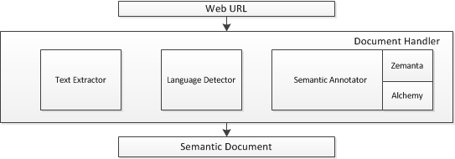
The Semantic Document Model
The main idea behind SNARC is to provide a uniform model for web entities, whether they are blog entries, multimedia objects or micro-posts

Slide 20
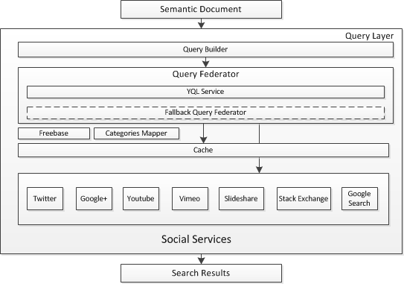
Querying Social Services

Slide 21
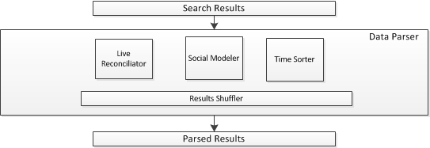
Reconciling Results

